Slide 1
Capstone 2: Correlating web traffic to external events
Jonas Cuadrado
October 30th, 2018

Slide 2


Motivation
Does a news article induce Wikipedia traffic?
or...
Does a Wikipedia traffic peak is followed by news?

Slide 3
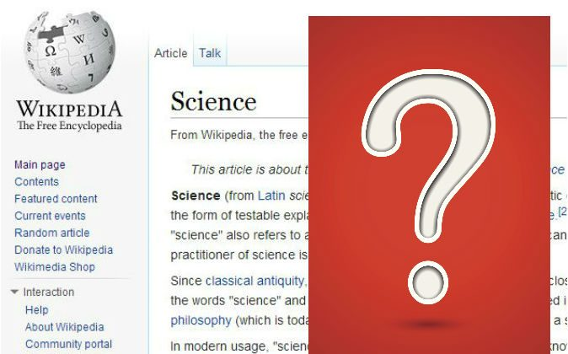
Other motivation
What makes a Wikipedia article relevant?

Slide 4
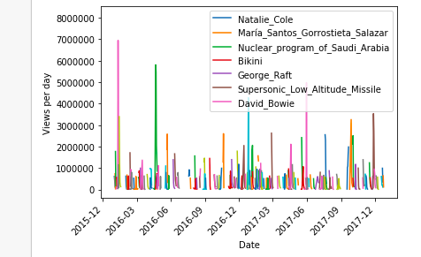
Data exploration: Wikipedia traffic

Slide 5
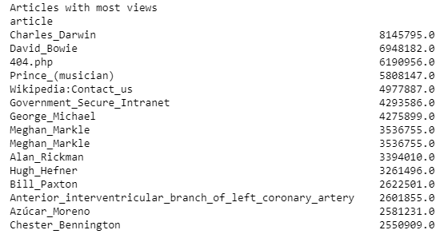
Data exploration: Wikipedia traffic

Slide 6
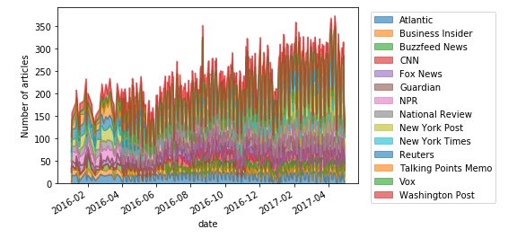
Data exploration: News dataset

Slide 7
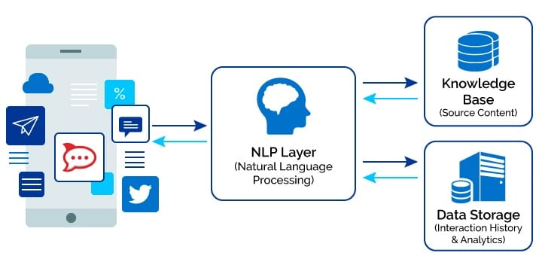
Topic modelling: NLP

Slide 8
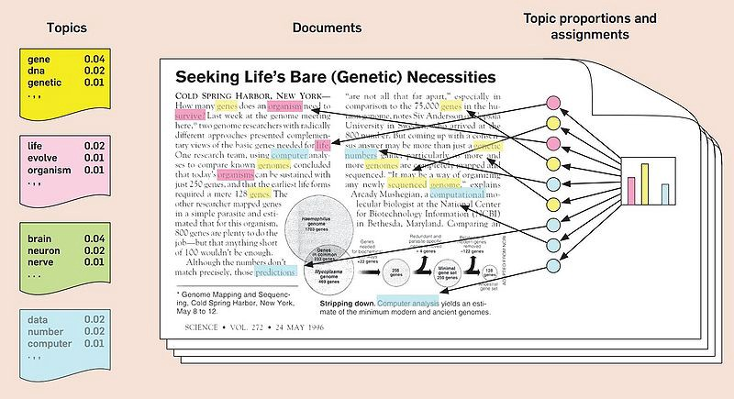
Topic modelling: LDA

Slide 9
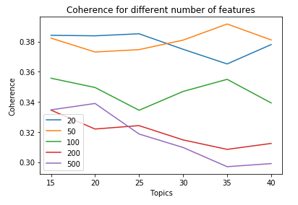
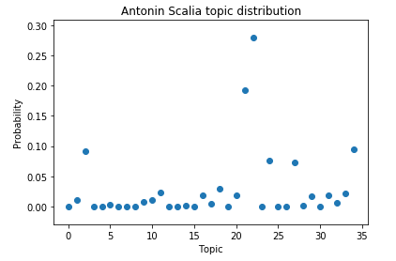
LDA Performance

Slide 10
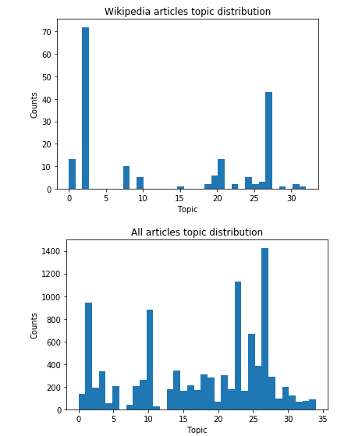
Topic distribution

Slide 11
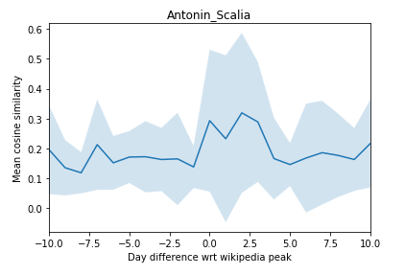
Similarities and correlation

Slide 12
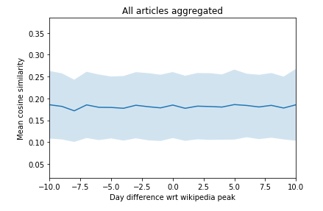
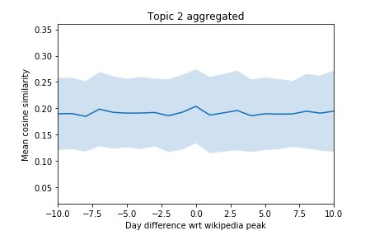
Similarities and correlation

Slide 13
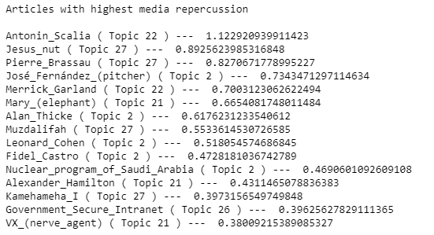
Similarities and correlation

Slide 14
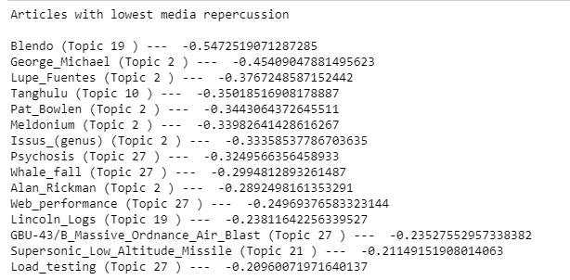
Similarities and correlation

Slide 15
Conclusions
The Wikipedia searches evidence what people are interested in, irrespective of where that interest is coming from.
In some cases, like politics or technical concepts, the interest may come from a breaking news article that gets developed afterwards.
In other, like events regarding entertainment, they may come other source like social media.
This information can be used to measure the impact of news articles in the people’s interests.

